Slide 1
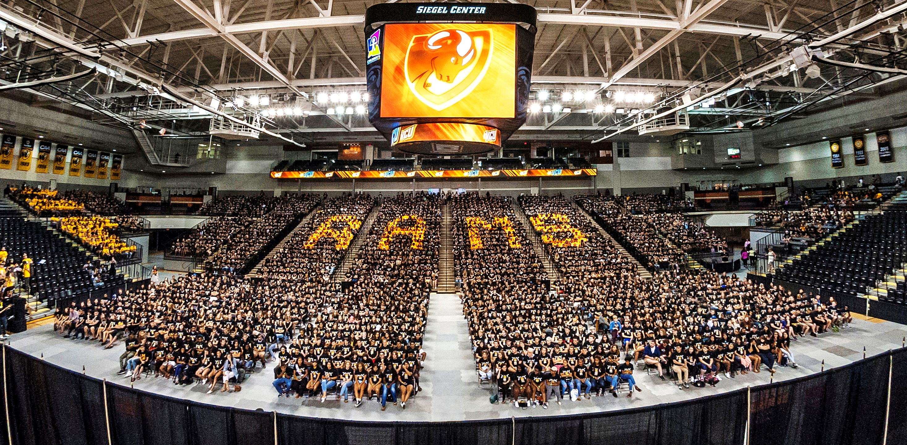
VCU Board of Visitors Strategic Planning Committee
KAROL KAIN GRAY
Senior Vice President & CFO
April 22, 2022

Slide 2
FY2023 E&G Overview
 | Proposed Increase Range
Proposed FY2023 Tuition Rate Increase | 3.0% | 3.0%
State Budget Range | High | Low
FY2023 Projected Revenue Growth
Tuition & Enrollment Change | $ 9,634 | $ 9,634
Change in State Support (W/ Salary Support) | 29,116 | 21,316
Total Revenue Growth | 39,852 | 43,360
Proposed FY2023 Projected Needs
Proposed New Expense Needs (W/ $23M Salary) | (54,065) | (54,065)
University Net Position | $ (15,314) | $ (23,114)
Reallocations (2.1% with High & 3.9% with Low) | 15,314 | 23,114
Revised University Net Position | $ 0 | $ 0

